Slide 1


Application By:

Slide 2
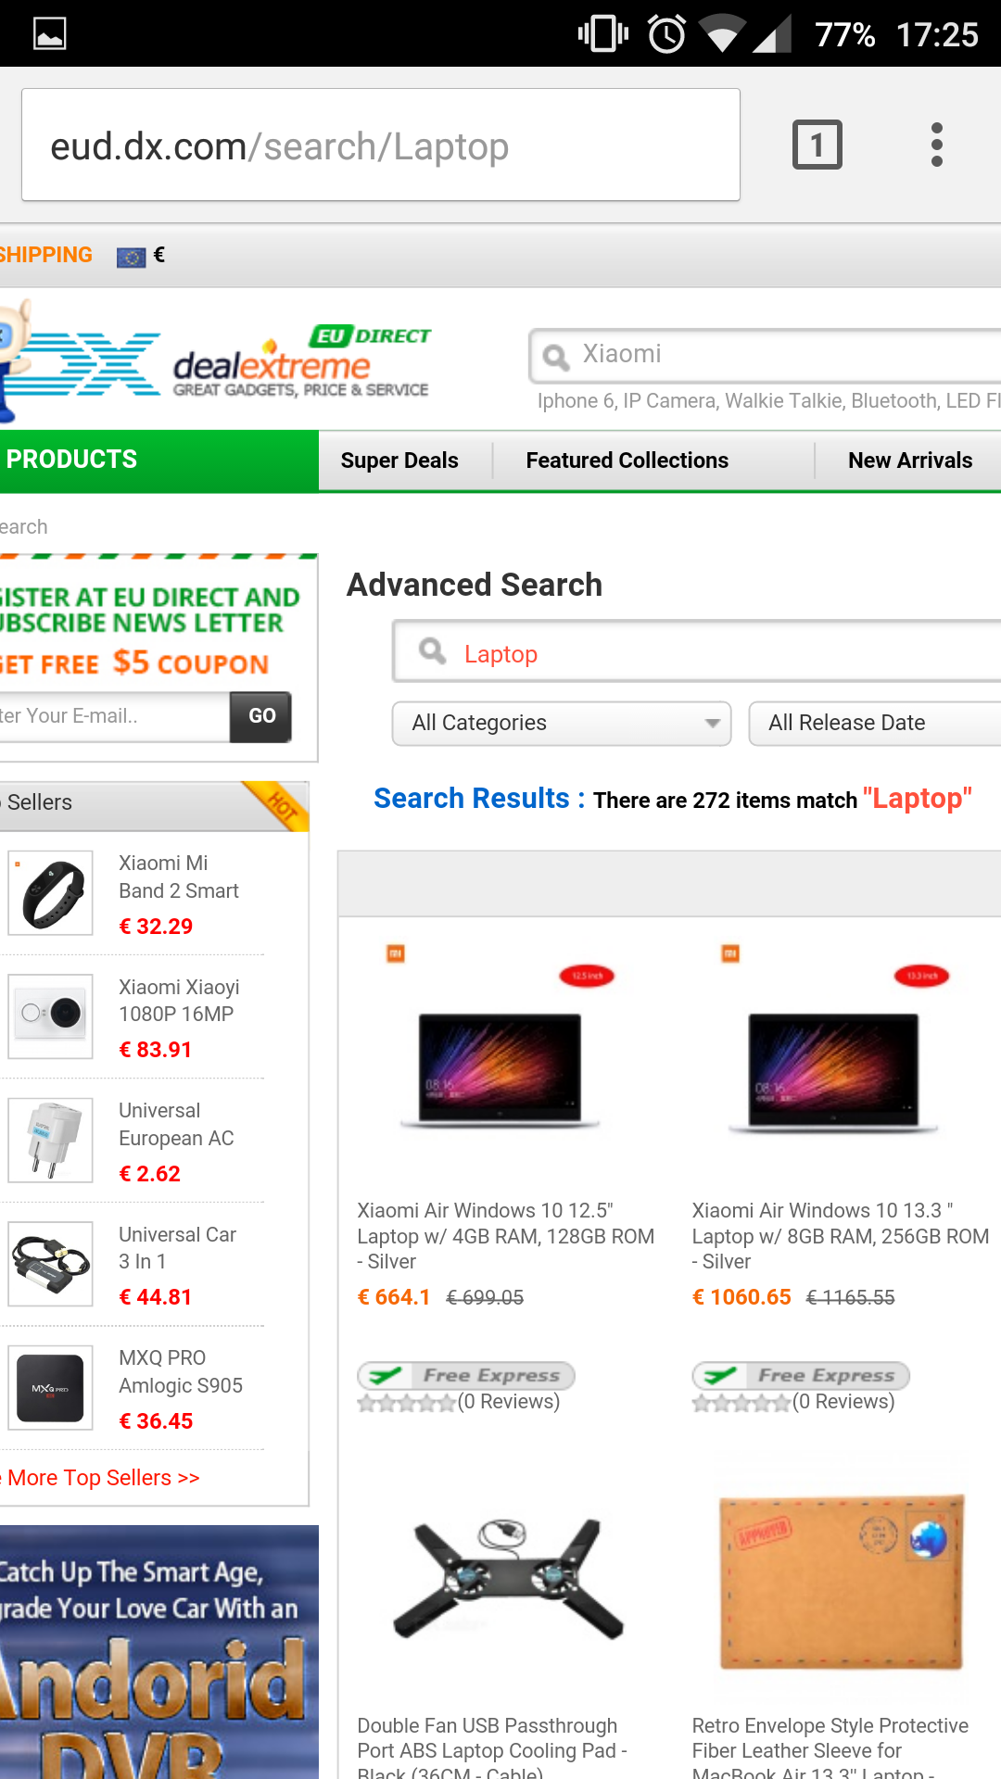
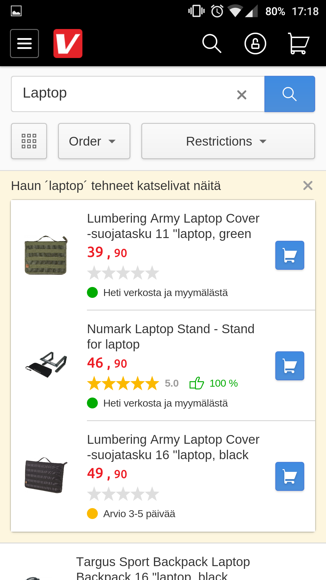
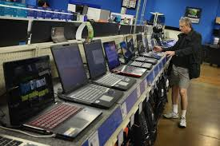
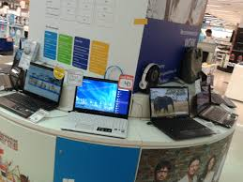
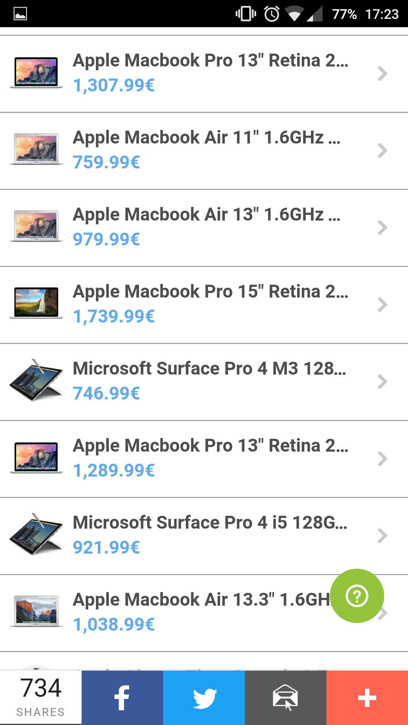

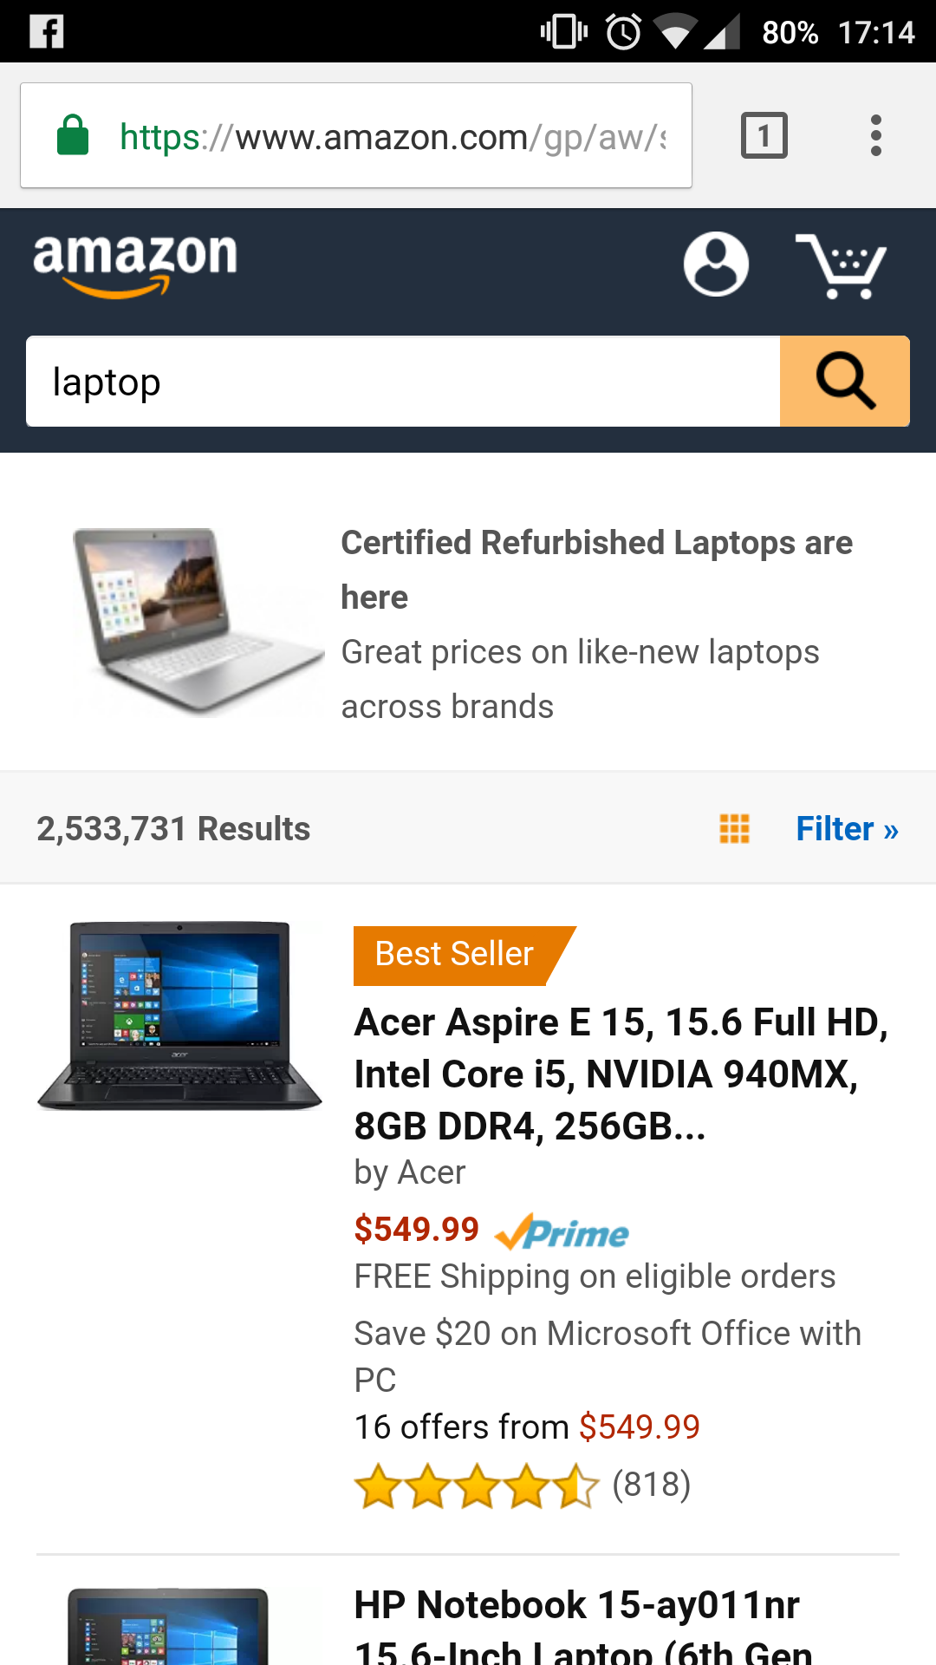
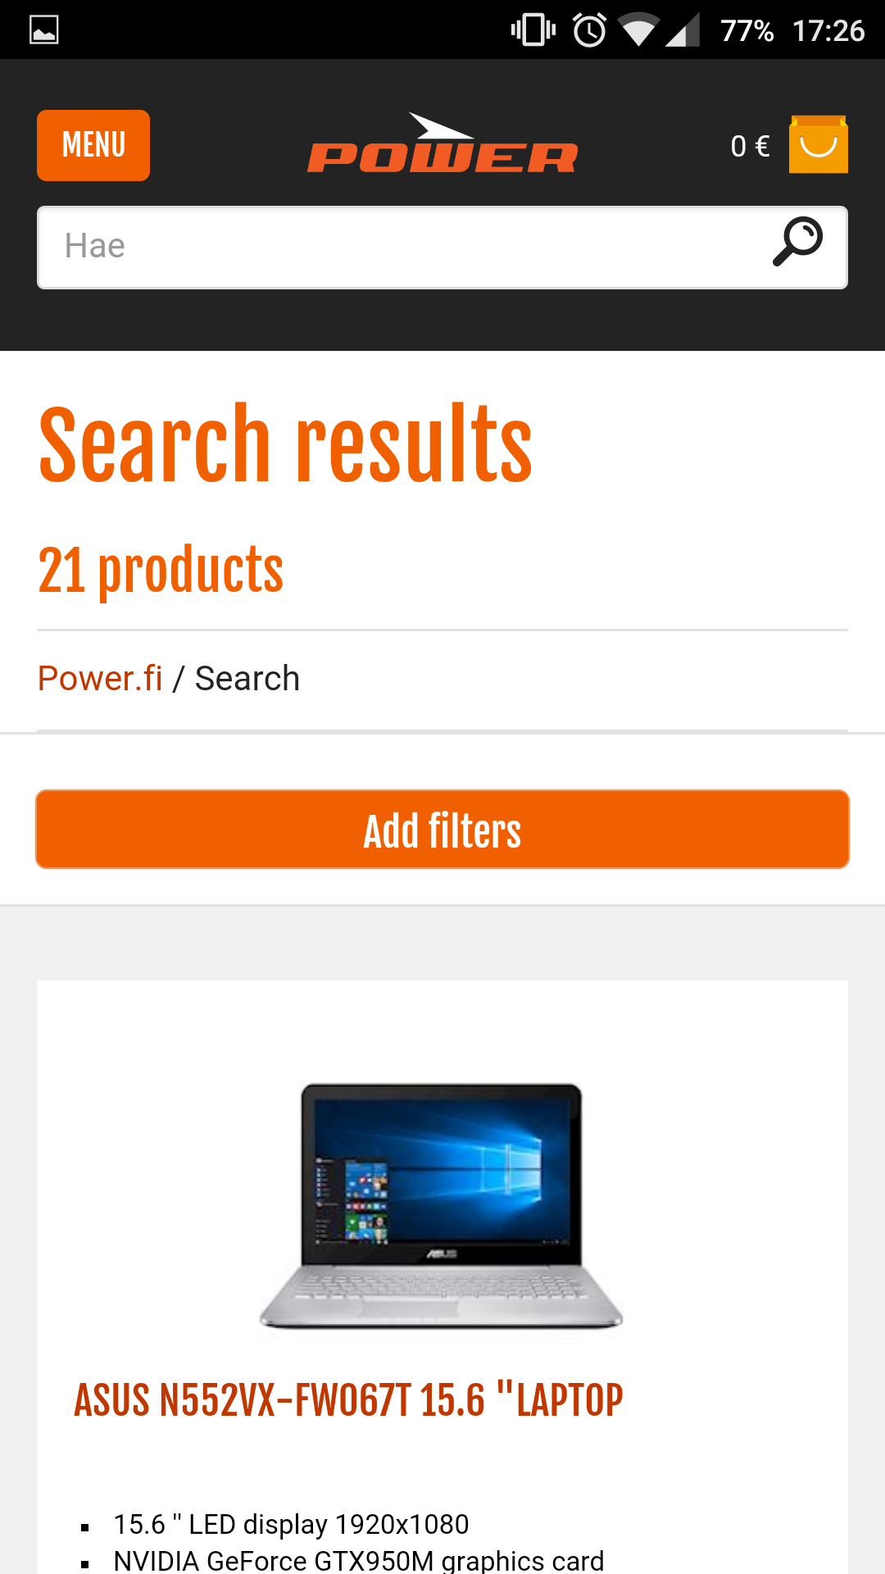
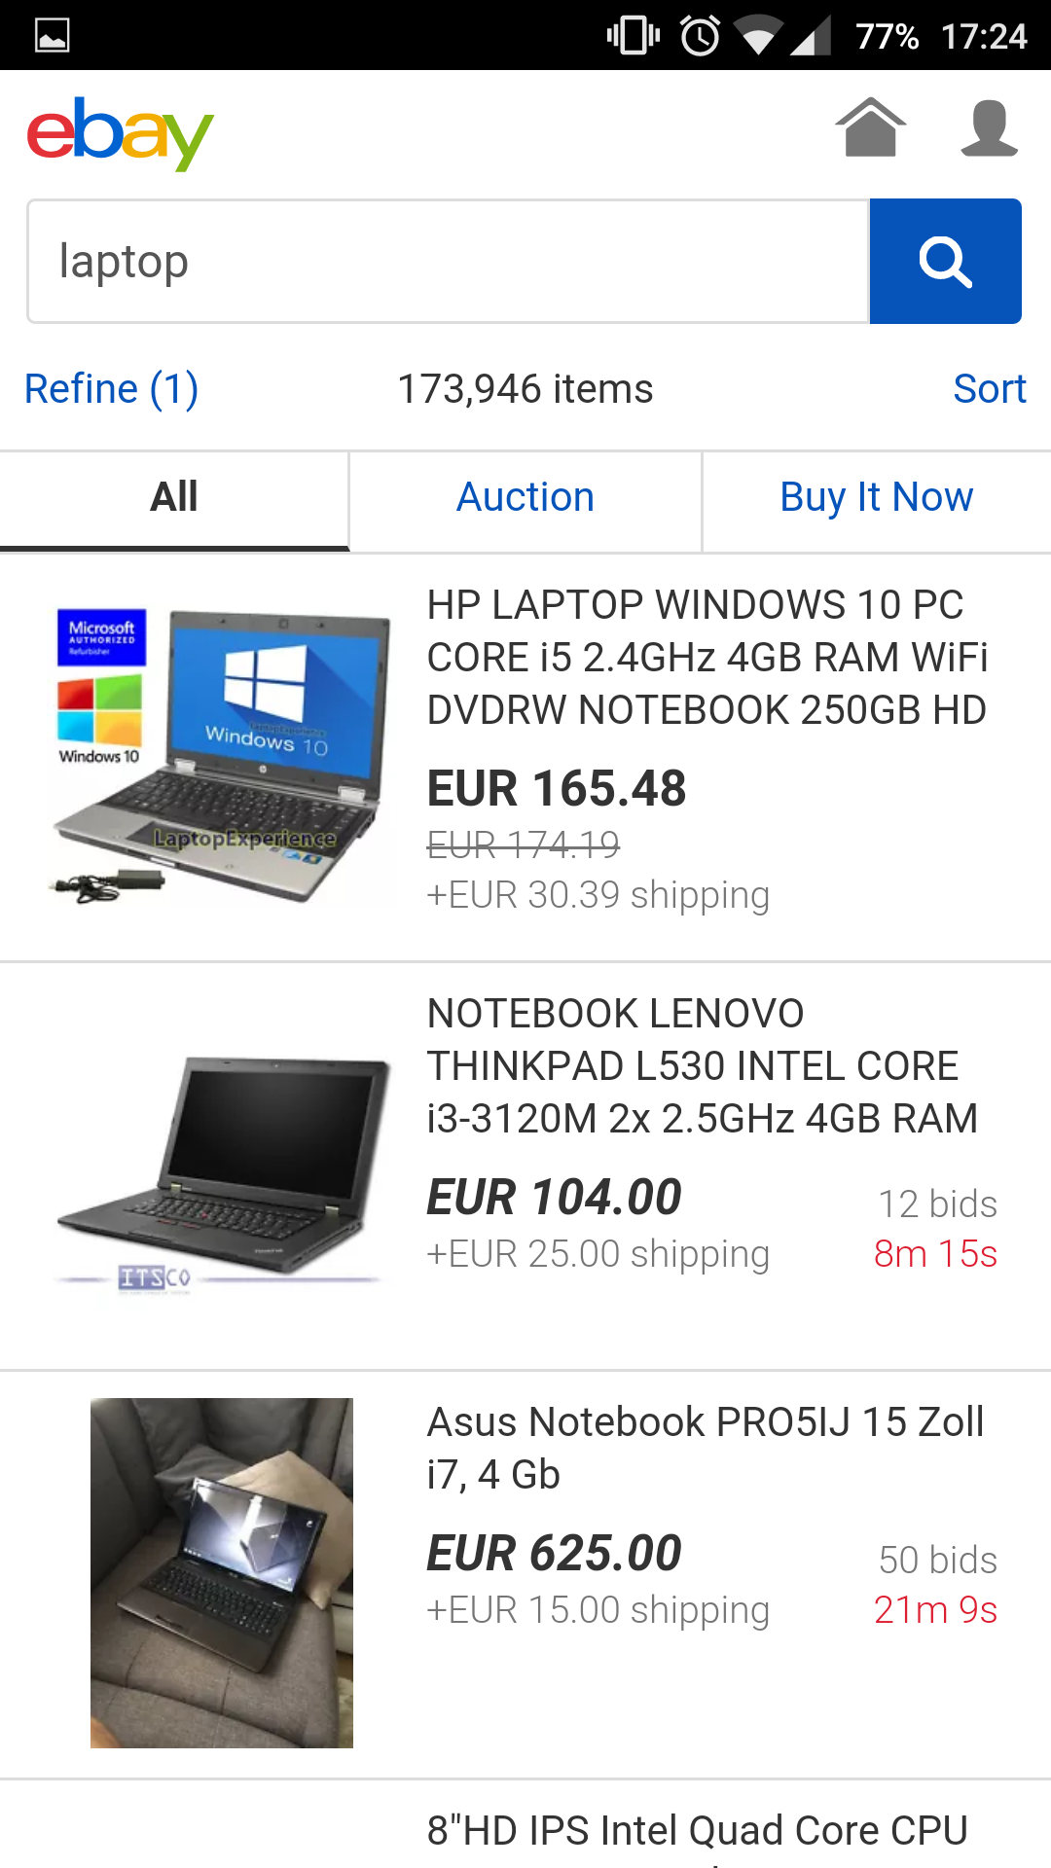
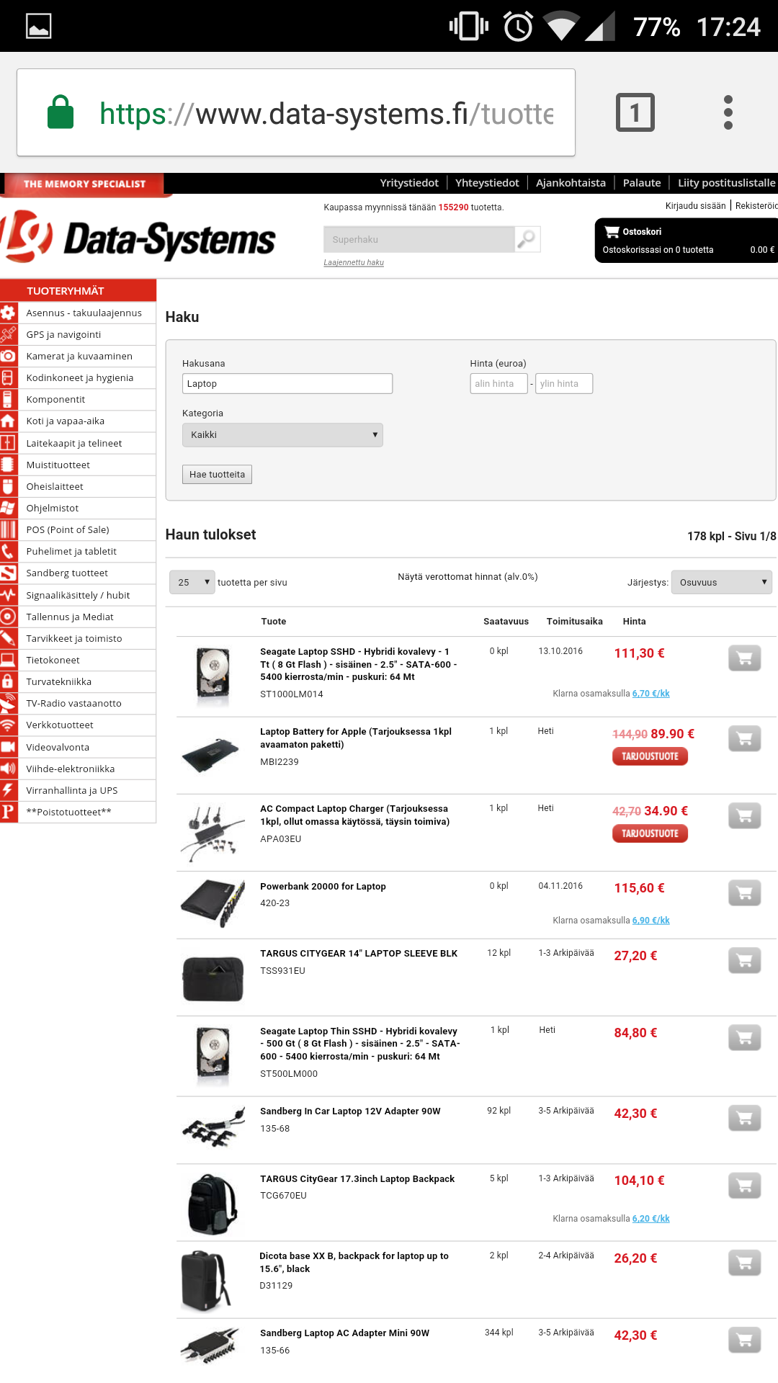

What does a human have to do to buy something?

Slide 3

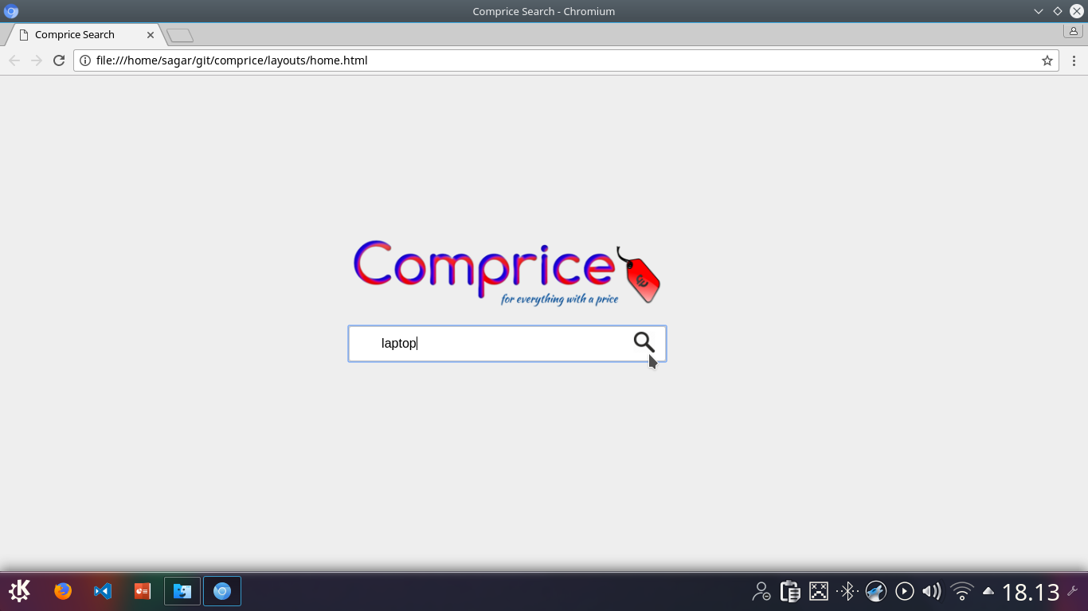
OR…

Slide 4
Comprice? What?
A search engine for products and services
Like Google, for things with a price tag
Just a little better

Slide 5
Market Void
- Existing product search engines do not include local providers
- Customers have to visit each store to check prices in local stores
- There is no application that gives comprehensive solution to users’ product and service requirements

Slide 6
The Solution
- Localized product search engine
- Comparison with online shops and vendors
- Comprehensive indexing based on users’ requirements
- Driving distances to local stores
That’s exactly what Comprice does

Slide 7


Core Customers
Application Consumer
- Uses the application to discover products and services
-Provides reviews for the product or service
-Helps to create a marketing platform for local stores and shopping chains to exploit
-Saves time by using a one stop shopping application
Business Costumer
-Pays subscription fees to subscribe to suitable scheme
-Advertises its products and services to local consumers
-Gets marketing platform and competitive edge over online competitors
-Expands its reach and profit

Slide 8


Competition
SmartShopper
-Data only from major online stores
-No local data and filter options
Hintaopas.fi
-Purely local
-No radius based filtration
-Can not serve as marketing platform

Slide 9
Marketing
- Free trials to the business costumers to expand the database
-Social Media marketing
-Video Ads
-Advertising with local stores

Slide 10
Revenue Streams
- Subscription Charges
- Paid product features
- Referencing to online stores
- Online ad APIs

Slide 11
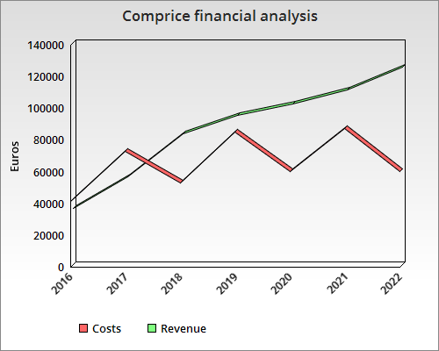
Growth Projection
- Estimated launch by Q2 2017
- European and American Markets by 2019
- Worldwide launch by 2021

Slide 12



The Team
Sandesh Poudel
Backend developer
2 years in freelance programming and consultation
Sagar Aryal
Fullstack Developer/ Market Strategist
2 years of startup experience in web development
1 year of market research
Sushil Bastola
Fullstack developer
1.5 years in the web development industry

